Slide 1
Setting up Private Registry

Slide 2
What is Docker Registry?
A Docker Registry is a place to store and distribute Docker images.
It serves as a target for your docker push & docker pull commands.
(OR)
The Registry is a stateless, highly scalable server side application that stores and lets you distribute Docker images.
Notes:
Key Points:
Docker registry is a repository for Docker images. Using Docker registry, you can build and share images with your team. A regis try can be public or private.

Slide 3
Docker Registry
A Docker Registry stores the layers and the description of how they make up an image
Implements a common API agreed upon by Docker clients
Several Implementations
A simple web server to make images available
A complete web application
Service – Docker Hub and Docker Trusted Registry
Notes:
Key Points:
Docker registry is a repository for Docker images. Using Docker registry, you can build and share images with your team. A regis try can be public or private.

Slide 4
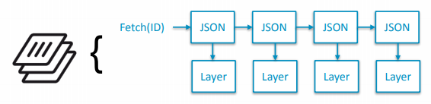
Docker Registry API V1
Layer Oriented
Layer IDs are randomly assigned
JSON object corresponding to each layer referencing a parent
Naming accomplished through tags

Slide 5
Registry API V1 URL Layout
Methods
GET | /v1/_ping
GET, PUT | /v1/images/(image_id)/layer
GET, PUT | /v1/images/(image_id)/json
GET | /v1/images/(image_id)/ancestry
GET | /v1/repositories/(namespace)/(repository)/tags
GET, PUT, DELETE | /v1/repositories/(namespace)/(repository)/tags/(tag*)
DELETE | /v1/repositories/(namespace)/(repository)/
GET | /v1/search

Slide 6
Docker Registry API V2 - Goals
Simplicity
Easy to implement
Works with static host
Security
Verifiable Images
Straightforward access control
Distribution
Separate location of content from naming

Slide 7
Docker Registry API V2 - Goals
Performance
Remove the single track
Implementation
Use Go to increase code sharing with Docker Eng

Slide 8
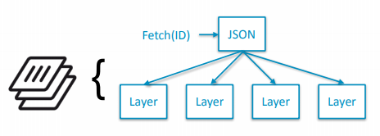
Docker Registry API V2: Manifests
Describes the components of an image in a single object
Layers can be fetched immediately, in parallel

Slide 9
Docker Registry API V2: Repositories
All content is now part of a named repository
Image IDs are no longer a secret
Simplified authorization model
repository + operation (push, pull)
Clients must “prove” content is available to another repository by providing it •
Opened up namespace to allow more than two components
No reason to have registry enforce “/”
API “reversed” to make static layout easier

Slide 10
Registry API V2 URL Layout
Methods | URL
GET | /v2/
GET | /v2/<name>tags/list
GET | /v2/<name>/blobs/<digest>
GET, PUT, DELETE | /v2/<name>/manifests/<reference>
POST | /v2/<name>blobs/uploads/
GET | /v2/<name>/blobs/<digest>

Slide 11
Docker Registry API V2 vs. V1
Content addresses (digests) are primary identifier
Unrolled image description model
Multi-step upload
Provides flexibility in failure modes
Options for future alternative upload location (redirects)
No Search API
In V1, this API does everything
Replacing with something better
No explicit tagging API
This will change: https://github.com/docker/distribution/pull/173

Slide 12
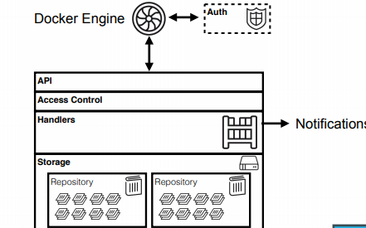
Docker Registry 2.0: Architecture

Slide 13
Docker Registry 2.0
Full support released with Docker 1.6
Minimal bugs
Most problems are common to version upgrades
Header required to declare support for 2.0 API
Validated most concepts in 1.3, 1.4 with V2 preview
Much faster pull performance
You’ve probably already used it with Docker Hub

Slide 14
Docker Registry 2.0…
There are some edge cases
push-heavy workflows
disk IO when verifying large images
We are mitigating these

Slide 15
Why Use It?
You should use the Registry if you want to:
Tightly control where your images are being stored
Fully own your images distribution pipeline
Integrate image storage and distribution tightly into your in-house development workflow

Slide 16
Terminology - Docker Registries
Image
An image is essentially a template for Docker containers. It consists of a manifest and an associated series of layers.
Layer
A layer represents a filesystem difference.
An image’s layers are combined together into a single image that forms the base for a container’s filesystem.
Registry
A registry is a content delivery and storage system for named Docker images.

Slide 17
Terminology - Docker Registries (Cont.)
Repository
A repository is simply a collection of different versions for a single Docker image.
Similar to a git repository.

Slide 18
Terminology - Docker Registries (Cont.)
Tag
A tag is just a named version of the image.
It allows you to identify a specific image later on.
You can tag an image (almost) however you want.
Best is to give it a meaningful, human-readable name.

Slide 19
Alternatives
Users looking for a zero maintenance
Ready-to-go solution are encouraged to head-over to the Docker Hub
which provides a free-to-use, hosted Registry,
additional features (organization accounts, automated builds, and more).
Users looking for a commercially supported version of the Registry should look into Docker Trusted Registry.

Slide 20
Requirements
The Registry is compatible with Docker engine version 1.6.0 or higher.
Basic commands
Start your registry
docker run -d -p 5000:5000 --name registry registry:2
Pull (or build) some image from the hub
docker pull ubuntu

Slide 21
Basic Commands ..
Tag the image so that it points to your registry
docker image tag ubuntu localhost:5000/myfirstimage
Push it
docker push localhost:5000/myfirstimage
Pull it back
docker pull localhost:5000/myfirstimage
Now stop your registry and remove all data
docker container stop registry && docker container rm -v registry

Slide 22
Docker Machine Overview
Install and run Docker on Mac or Windows
Provision and manage multiple remote Docker hosts
Provision Swarm clusters

Slide 23
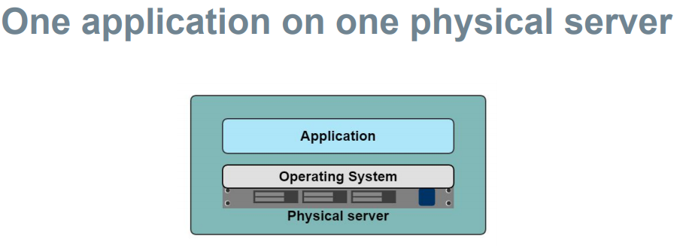
Docker Machine

Slide 24
What is Docker Machine?
Docker Machine is a tool
Lets you install Docker Engine on virtual hosts, and manage the hosts with docker-machine commands.
Use Machine to create Docker hosts on your local Mac or Windows box,
On your network, in your data center,
On cloud providers like Azure, AWS, or Digital Ocean.

Slide 25
Docker Machine
Using docker-machine commands,
can start, inspect, stop, and restart a managed host, upgrade the Docker client and daemon, and configure a Docker client to talk to your host.

Slide 26
Why should I use Docker Machine?
Docker Machine enables you to provision multiple remote Docker hosts on various flavors of Linux.
Additionally, Machine allows you to run Docker on older Mac or Windows systems, as described in the previous topic.

Slide 27
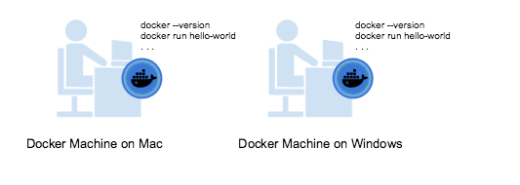
Docker Machine Use cases
I have an older desktop system and want to run Docker on Mac or Windows

Slide 28
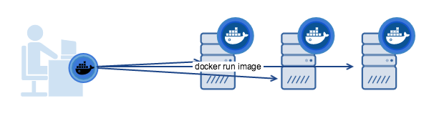
Docker Machine Use cases
I want to provision Docker hosts on remote systems

Slide 29
Docker Engine vs Docker Machine
Docker” they typically mean Docker Engine
the client-server application made up of the Docker daemon
a REST API that specifies interfaces for interacting with the daemon
command line interface (CLI) client that talks to the daemon (through the REST API wrapper)
Docker Engine accepts docker commands from the CLI, such as docker run <image>, docker ps to list running containers, docker image ls to list images, and so on.

Slide 30
Docker Engine vs Docker Machine
Docker Machine is a tool for provisioning and managing your Dockerized hosts
Install Docker Machine on your local system. Docker Machine has its own command line client docker-machine and the Docker Engine client, docker.

Slide 31
Docker Engine vs Docker Machine
Docker Machine is a tool for provisioning and managing your Dockerized hosts
Install Docker Machine on your local system. Docker Machine has its own command line client docker-machine and the Docker Engine client, docker.

Slide 32
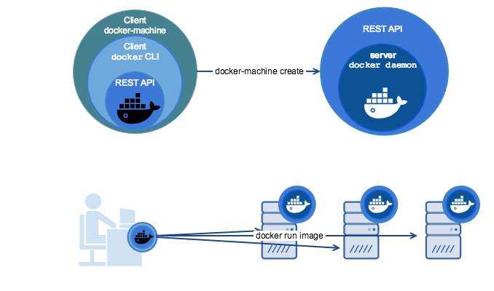
Docker Engine vs Docker Machine

Slide 33
Install Docker Machine
On macOS and Windows, Machine is installed along with other Docker products when you install the Docker for Mac, Docker for Windows, or Docker Toolbox.

Slide 34
Install Docker Machine
Install Docker.
Download the Docker Machine binary and extract it to your PATH.
If you are running on Linux:
$base=https://github.com/docker/machine/releases/download/v0.16.0 && curl -L $base/docker-machine-$(uname -s)-$(uname -m) >/tmp/docker-machine && sudo install /tmp/docker-machine /usr/local/bin/docker-machine

Slide 35
Install Docker Machine
Check the installation by displaying the Machine version:
$ docker-machine version docker-machine version 0.16.0, build 9371605
Install bash completion scripts
The Machine repository supplies several bash scripts that add features such as:
command completion
a function that displays the active machine in your shell prompt
a function wrapper that adds a docker-machine use subcommand to switch the active machine

Slide 36
How to uninstall Docker Machine
To remove each machine individually:
docker-machine rm <machine-name>
To remove all machines:
docker-machine rm -f $(docker-machine ls -q) (you might need to use -force on Windows).

Slide 37
Create a host using Docker Machine on different platforms
Docker Machine driver plugins are available for many cloud platforms,
can use Machine to provision cloud hosts.
When you use Docker Machine for provisioning, can create cloud hosts with Docker Engine installed on them.
Install and run Docker Machine, and create an account with the cloud provider.

Slide 38
Create a host using Docker Machine on different platforms
provide account verification, security credentials, and configuration options for the providers as flags to docker-machine create
For instance, to pass a Digital Ocean access token you use the --digitalocean-access-token flag.

Slide 39
Create a host using Docker Machine on different platforms
Examples:
For Digital Ocean, this command creates a Droplet (cloud host) called “docker-sandbox”.
$ docker-machine create --driver digitalocean --digitalocean-access-token xxxxx docker-sandbox
For AWS EC2, this command creates an instance called “aws-sandbox”:
$ docker-machine create --driver amazonec2 --amazonec2-access-key AKI******* --amazonec2-secret-key 8T93C******* aws-sandbox

Slide 40
The docker-machine create command
The docker-machine create command typically requires that you specify, at a minimum:
--driver - to indicate the provider on which to create the machine (VirtualBox, DigitalOcean, AWS, and so on)
Account verification and security credentials (for cloud providers), specific to the cloud service you are using
<machine> - name of the host you want to create

Slide 41
Add a host without a driver
Register an already existing docker host by passing the daemon url.
$ docker-machine create --driver none --url=tcp://50.134.234.20:2376 custombox
$ docker-machine ls

Slide 42
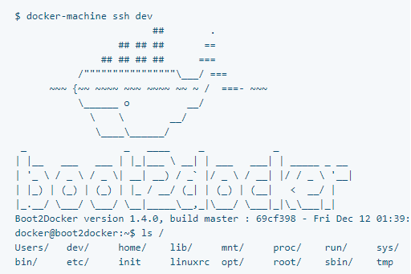
docker-machine ssh
Log into or run a command on a machine using SSH.
To login, just run docker-machine ssh machinename:

